Slide 1

Library Database Analysis
PRESENTED BY :
Y.K.Chakradhar Reddy
Ch.Venkatesh
Ch.Samuel

Slide 2
Introduction
This project, “Library Database Analysis,” focuses on managing and analyzing library data using SQL. It involves designing a relational database with tables like Books, Authors, Borrowers, and Library Branches, and writing queries to extract key insights such as book availability, borrower activity, and branch performance. The project helps in understanding data relationships, query optimization, and data-driven analysis in real-world scenarios.

Slide 3
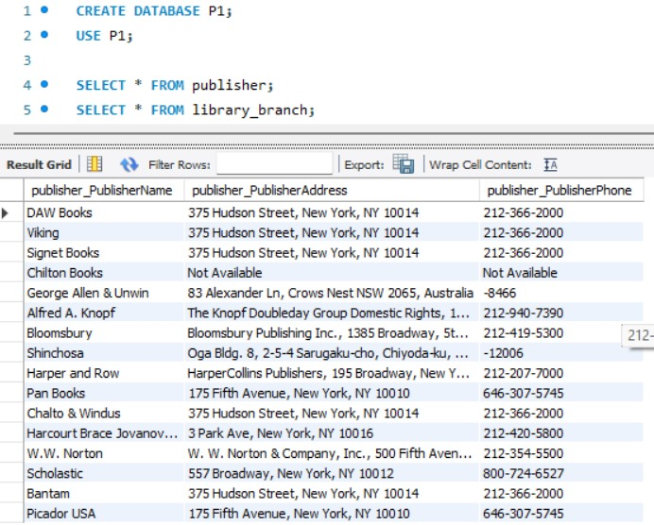
TABLES
PUBLISHER

Slide 4
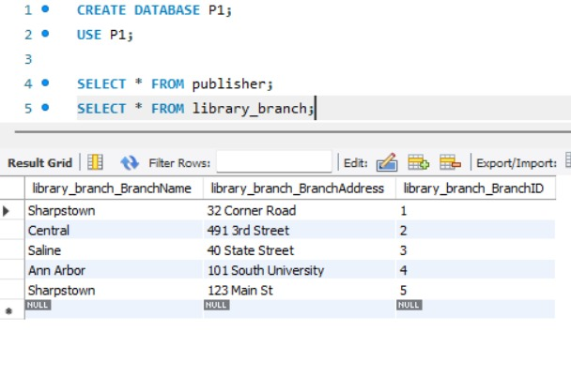
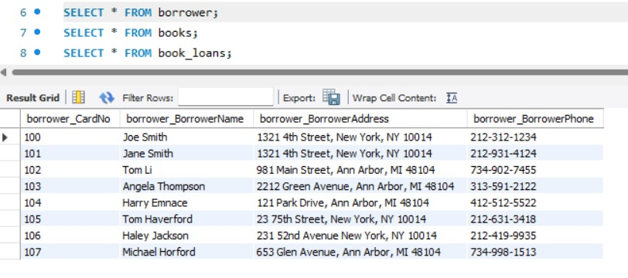
LIBRARY BRACNCH
BORROWER

Slide 5
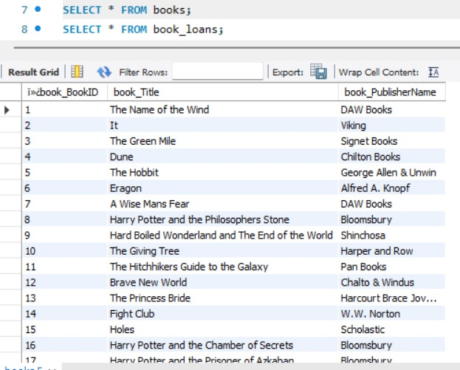
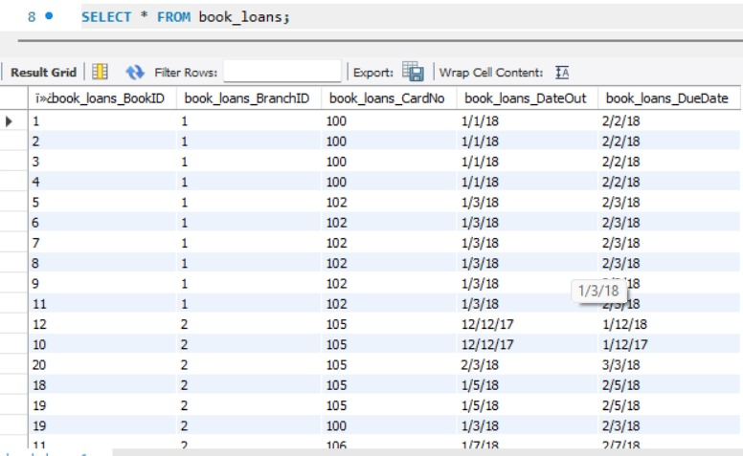
BOOKS
BOOK LOANS

Slide 6
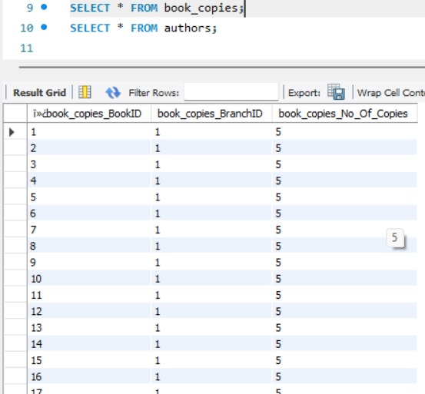
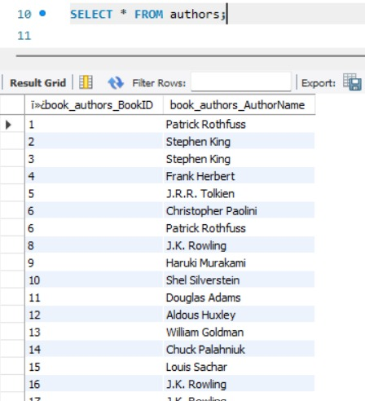
BOOK COPIES
AUTHORS

Slide 7
Problem Statement
The library needs an efficient system to store, manage, and analyze data related to books, authors, borrowers, and loans. Currently, tracking book copies, borrower details, and branch records is manual and time-consuming. The goal is to build an SQL-based database that can automate data retrieval and provide accurate insights for better decision-making.

Slide 8
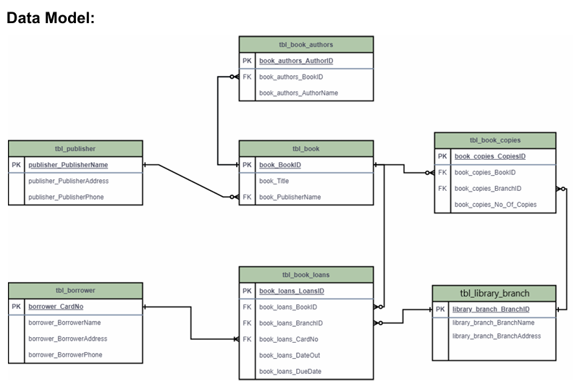
ER DIAGRAM

Slide 9
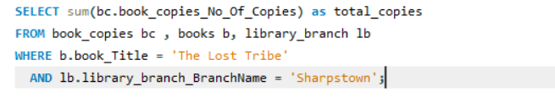
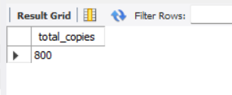
1. How many copies of the book titled "The Lost Tribe" are owned by the library branch whose name is "Sharpstown"?
Code
Output

Slide 10
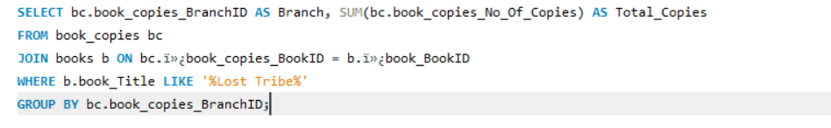
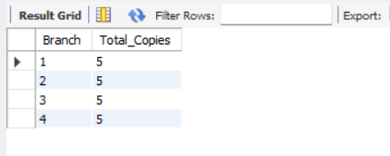
2. How many copies of the book titled "The Lost Tribe" are owned by each library branch?
Code
Output

Slide 11

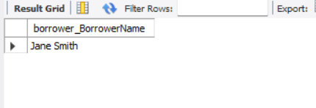
3. Retrieve the names of all borrowers who do not have any books checked out.
Code
Output

Slide 12
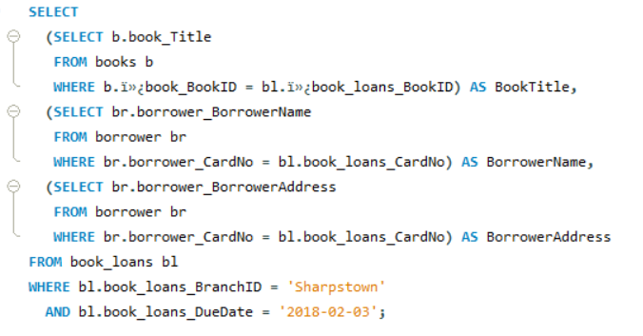
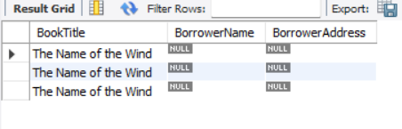
4. For each book that is loaned out from the "Sharpstown" branch and whose DueDate is 2/3/18, retrieve the book title, the borrower's name, and the borrower's address.
Code:
Output:

Slide 13
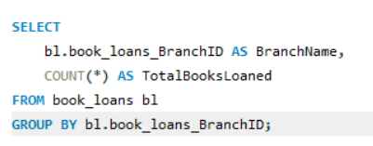
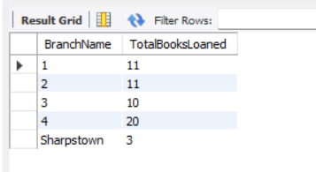
5. For each library branch, retrieve the branch name and the total number of books loaned out from that branch.
Code
Output

Slide 14
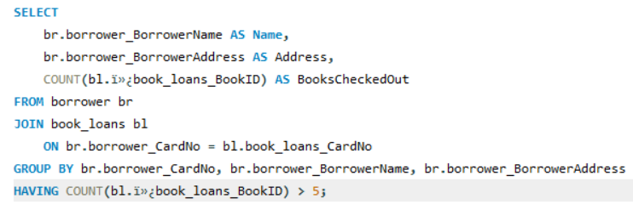
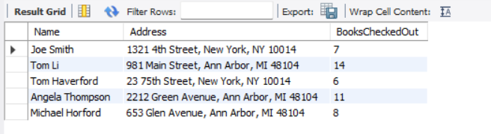
6. Retrieve the names, addresses, and number of books checked out for all borrowers who have more than five books checked out.
Code
Output

Slide 15
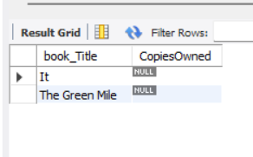
7. For each book authored by "Stephen King", retrieve the title and the number of copies owned by the library branch whose name is "Central".
Code
Output

Slide 16
Conclusion
The Library Database Analysis Project successfully demonstrated how SQL can be used to manage, organize, and analyze complex library data efficiently. By designing relational tables and executing analytical queries, we were able to extract key insights such as book availability, borrower activity, and branch performance. This project enhanced our understanding of data modeling, normalization, and query optimization, and highlighted the importance of databases in real-world data management and decision-making.

Slide 17

THANK YOU

